Slide 1
Deployable Trunking Systems
A standard approach to LMR system overload and complex incident management

Slide 2
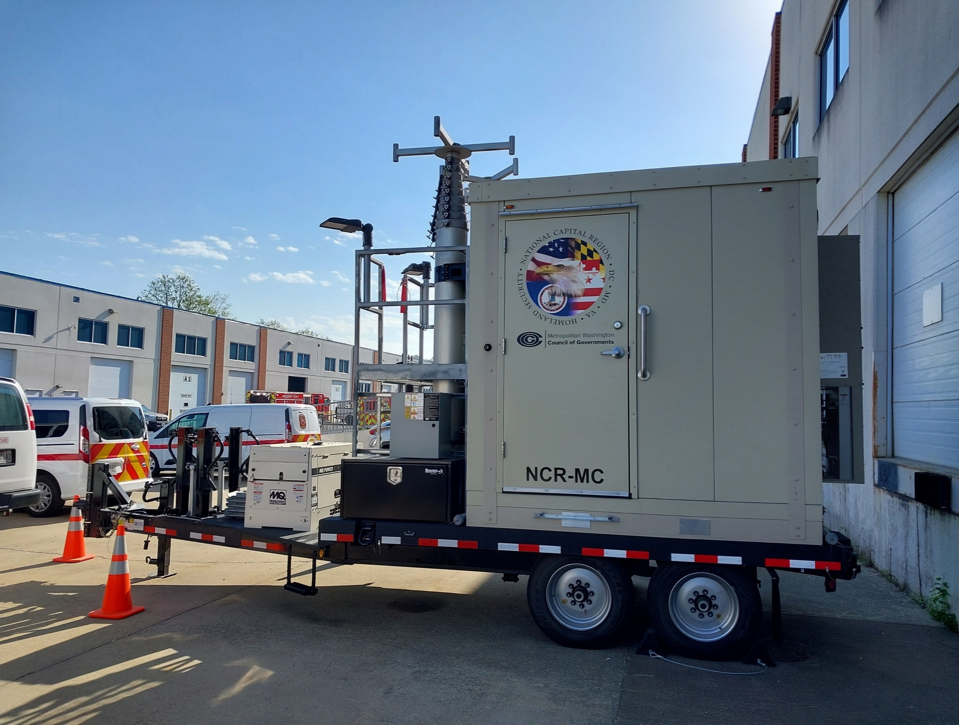
What is Deployable Trunking??
Just as it sounds – Deployable Trunking – is a Site-On-Wheels solution in a stand-alone radio system configuration.
All major LMR vendors have a version of Deployable Trunking available for purchase

Slide 3
What problem are we trying to solve??
Supports planned special events or unplanned extraordinary incidents with limited incident-based radio coverage
Removes extraordinary incident or special event radio traffic from a local communications system, maintaining capacity and resource availability for first responders engaged in jurisdictional operations.
Provides 32 talkgroups, in a 6-channel trunking configuration for command and tactical purposes, 16 of which are programmed for secure encrypted comms on national keys.
Can be accessed by a jurisdiction’s 9-1-1 Center or command vehicles through control stations

Slide 4
Standard – What Standard??
Well Almost…
The current deployable systems are all based on a nation Deployable Trunking Plan developed by the National Public Safety Telecommunications Council and the National Regional Planning Council.
In 2023, APCO formed the Deployable Trunking Standards Committee which is formulating an APCO standard largely based off this plan.

Slide 5
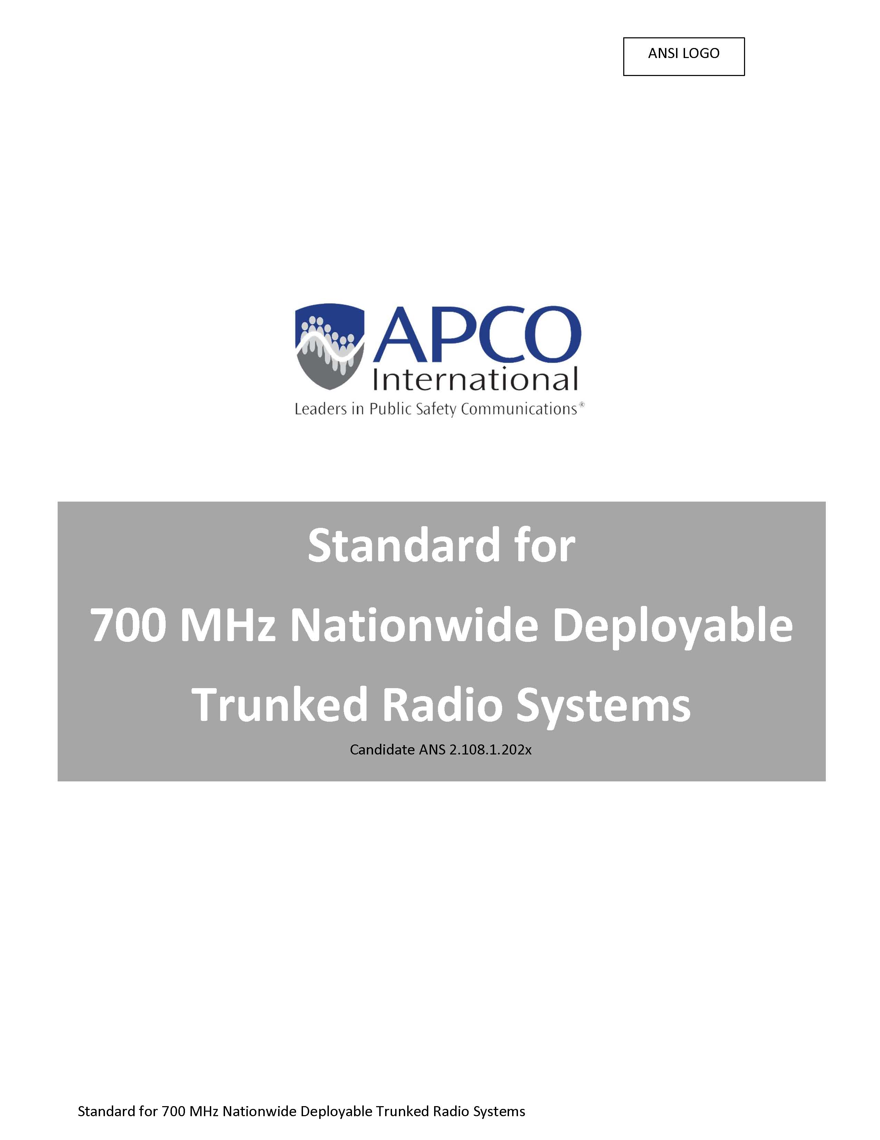
Standard – What Standard??
The APCO Standards Development Committee’s 700 MHz Deployable Public Safety Trunking Systems Working Group has taken the NPSTC Report as a starting point and has developed the Candidate Standard for 700 MHz Nationwide Deployable Trunked Radio Systems
The DRAFT Candidate Standard has been acknowledged by ANSI and released by APCO for public comment:
https://www.apcointl.org/services/standards/standards-review-comment/
The comment period closes on September 6, 2025
After any comments received are resolved, APCO will release the Standard for public use.

Slide 6
Spectrum? – Is it Legal
Yes!
In 2008, NPSTC petitioned the Federal Communications Commission (FCC) to designate spectrum from the unassigned 700 MHz reserve channels for deployable trunked radio systems.
In April 2015, following a multi-step rulemaking process involving numerous 700 MHz issues, the FCC approved six specific 12.5 kHz channel pairs from the 700 MHz reserve spectrum for deployable trunked system use outside TBand areas. (TBand restriction expired at the end of 2020)
The six specific 12.5 kHz channel pairs are consistent with recommendations NPSTC and the National Regional Planning Council (NRPC) jointly proposed in February 2015, as part of the rulemaking process following the original NPSTC request from 2010.

Slide 7
Challenges
Deployment – These systems require an in-depth knowledge of LMR and Tactical systems deployment. Your firefighters and police officers cannot just deploy this with success.
Cost – These systems are not cheap. They are expensive and require ongoing maintenance and upkeep. Like any other LMR system they will require ongoing maintenance over time.
Buy-In – Leaders are often reluctant to switch operations to a deployable system, leaving the comfort of their home systems. This is an educational need throughout the LMR community to explain-train-and educate these leaders in the benefits of the system.
P25 ID Management – There is a potential for ID conflicts in these systems. It is highly recommended that these systems remain open to ensure complete interoperability, with a monitoring system overlay to notify of potential ID conflicts.

Slide 8

The Standardized Template Concept
Provides uniformity of channel labeling throughout Region for repeated and direct/simplex use
Nomenclature is based upon national channel naming standards
Introduces new deployable trunking channels; up to 28 talkgroups
Provides six 700 MHz frequencies for regionwide RINS simplex use; these frequencies are NOT limited to a specific region however, are secondary to deployable trunking use
Standardizes low power 700 MHz frequency as to analog and digital use. Low power channels can be used throughout Region 20

Slide 9
The Standardized Template (R20)
Zone Name | Pos 1 | Pos 2 | Pos 3 | Pos 4 | Pos 5 | Pos 6 | Pos 7 | Pos 8 | Pos 9 | Pos 10 | Pos 11 | Pos 12 | Pos 13 | Pos 14 | Pos 15 | Pos 16
Standard Template | Standard Template | Standard Template | Standard Template | Standard Template | Standard Template | Standard Template | Standard Template | Standard Template | Standard Template | Standard Template | Standard Template | Standard Template | Standard Template | Standard Template | Standard Template | Standard Template
800 IO | 8CALL90 | 8TAC91 | 8TAC91D | 8TAC92 | 8TAC92D | 8TAC93 | 8TAC93D | 8TAC94 | 8TAC94D | BLANK | BLANK | BLANK | BLANK | BLANK | BLANK | BLANK
RINS 700D | RINS11D | RINS12D | RINS13D | RINS14D | RINS15D | RINS16D | RINS21LD | RINS22LD | RINS23LD | RINS24LD | RINS25LA | RINS26LA | RINS27LA | RINS28LA | RINS29LA | BLANK
RINS 800 | RINS1 | RINS1D | RINS 2 | RINS2D | RINS 3 | RINS3D | RINS 4 | RINS4D | RINS 5 | RINS5D | RINS 6 | RINS6D | BLANK | BLANK | BLANK | BLANK
700 IO D | 7AG88D | 7TAC51D | 7TAC52D | 7TAC53D | 7TAC54D | 7TAC55D | 7TAC56D | 7TAC71D | 7TAC72D | 7TAC73D | 7TAC74D | 7TAC75D | 7TAC76D | 7GTAC57D | 7GTAC77D | BLANK
700 IO R | 7CALL50 | 7TAC51 | 7TAC52 | 7TAC53 | 7TAC54 | 7TAC55 | 7TAC56 | 7TAC71 | 7TAC72 | 7TAC73 | 7TAC74 | 7TAC75 | 7TAC76 | 7GTAC57 | 7GTAC77 | 7CALL70
DEPLOY ZZ | CALL ZZ | CMD ZZ | TAC ZZ3 | TAC ZZ4 | TAC ZZ5 | TAC ZZ6 | TAC ZZ7 | TAC ZZ8 | TAC ZZ9 | TAC ZZ10 | TAC ZZ11 | TAC ZZ12 | TAC ZZ13 | TAC ZZ14 | TAC ZZ15 | EMER ZZ
DEPLOY YY | CALL YY | CMD YY | TAC YY3 | TAC YY4 | TAC YY5 | TAC YY6 | TAC YY7 | TAC YY8 | TAC YY9 | TAC YY10 | TAC YY11 | TAC YY12 | TAC YY13 | TAC YY14 | TAC YY15 | EMER YY
700 LAW | 7LAW61 | 7LAW61D | 7LAW62 | 7LAW62D | 7LAW81 | 7LAW81D | 7LAW82 | 7LAW82D | 7MOB59 | 7MOB59D | 7MOB79 | 7MOB79D | BLANK | BLANK | BLANK | BLANK
700 FIRE | 7FIRE63 | 7FIRE63D | 7FIRE64 | 7FIRE64D | 7FIRE83 | 7FIRE83D | 7FIRE84 | 7FIRE84D | 7MOB59 | 7MOB59D | 7MOB79 | 7MOB79D | BLANK | BLANK | BLANK | BLANK
700 MED | 7MED65 | 7MED65D | 7MED66 | 7MED66D | 7MED85 | 7MED85D | 7MED86 | 7MED86D | 7MOB59 | 7MOB59D | 7MOB79 | 7MOB79D | BLANK | BLANK | BLANK | BLANK
Optional Tempate | Optional Tempate | Optional Tempate | Optional Tempate | Optional Tempate | Optional Tempate | Optional Tempate | Optional Tempate | Optional Tempate | Optional Tempate | Optional Tempate | Optional Tempate | Optional Tempate | Optional Tempate | Optional Tempate | Optional Tempate | Optional Tempate
MD CALL | MD CALL | MD TAC 1 | MD TAC 2 | MD TAC 3 | MD TAC 4 | MD TAC 5 | MD TAC 6 | MD TAC 7 | MD TAC 8 | MD TAC 9 | MD TAC 10 | MD TAC 11 | MD TAC 12 | MD TAC 13 | MD TAC 14 | MD TAC 15
MD LAW | MD CALL | MD LAW 1 | MD LAW 2 | MD LAW 3 | MD LAW 4 | MD LAW 5 | MD LAW 6 | MD LAW 7 | MD LAW 8 | MD LAW 9 | MD LAW 10 | MD LAW 11 | MD LAW 12 | MD LAW 13 | MD LAW 14 | MD LAW 15
MD EVENT | MD CALL | MD EV‐1 | MD EV‐2 | MD EV‐3 | MD EV‐4 | MD EV‐5 | MD EV‐6 | MD EV‐7 | MD EV‐8 | MD EV‐9 | MD EV‐10 | MD EV‐11 | MD EV‐12 | MD EV‐13 | MD EV‐14 | MD EV‐15
USAWIDE | 7‐US‐01D | 7‐US‐02D | 7‐US‐03D | 7‐US‐04D | 7‐US‐05D | 7‐US‐06D | BLANK | BLANK | BLANK | BLANK | BLANK | BLANK | BLANK | BLANK | BLANK | BLANK

Slide 10
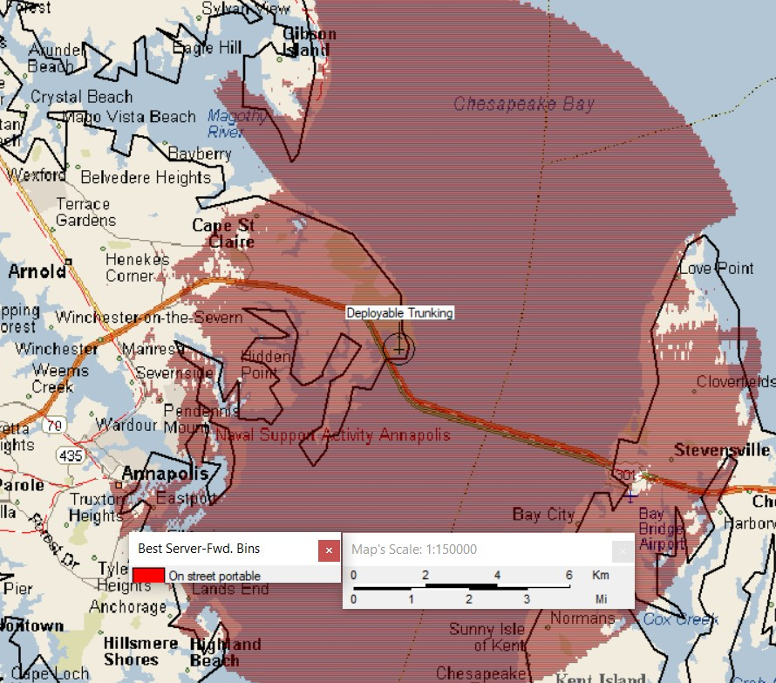
DT System Coverage
Sandy Point
Propagation based upon: 40 watts RF output
5.9 dB gain antenna mounted at 66’ AGL
2.5 watt portable radio

Slide 11
DT Lessons Learned
Coverage, Coverage, Coverage!
Multiple systems cannot be used in the same proximity
Pre-Programming of a Standard Template is a MUST
SOW must remain an OPEN system for interoperability
Any secondary channel use must be considered before placing the DT in service
A system monitoring service (i.e. Genisis) overlay makes life much easier

Slide 12
FAQ’s
How much do these cost
Can I use this as a backup site for my home LMR system
What happens if I get two ID’s in two different subscribers on the system
Do I have to use the YY zone in encrypted mode only
Can you share the Region 20 Interoperability Template

Slide 13
Conclusion
Deployable Trunking is a tactical, or fixed solution to shedding traffic and freeing up capacity during planned or unplanned events
These systems are all based on a national plan soon to be a national standard.
They provide an excellent means of resiliency for events in the form factor of a stand alone LMR radio system.

Slide 14
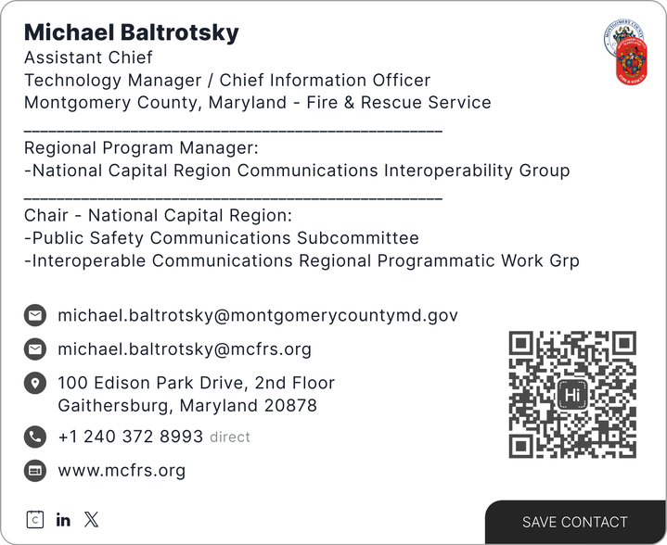
Questions??
Donald Root Project 25 Program Manager APCO International (804) 499-8940 rootd@apcointl.org

